Slide 1



Sales Performance Dashboard
(2003–2005)
Analyzing Sales Trends, Product Performance, and Customer Insights
Prepared by Mohammed Arshad Jawahir— Data Analyst

Slide 2
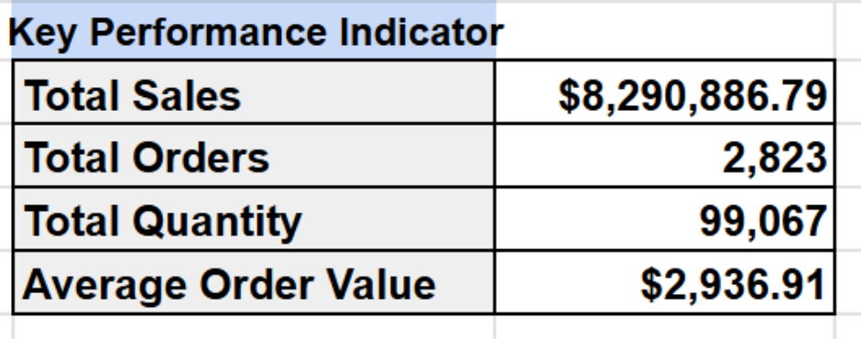
Executive Summary & Key Metrics
Key Performance Indicator
Total sales of $8.29M from Jan 2003–May 2005.
Average order value $2,936.91.
Dashboard reveals seasonal trends and strong US & European markets.

Slide 3
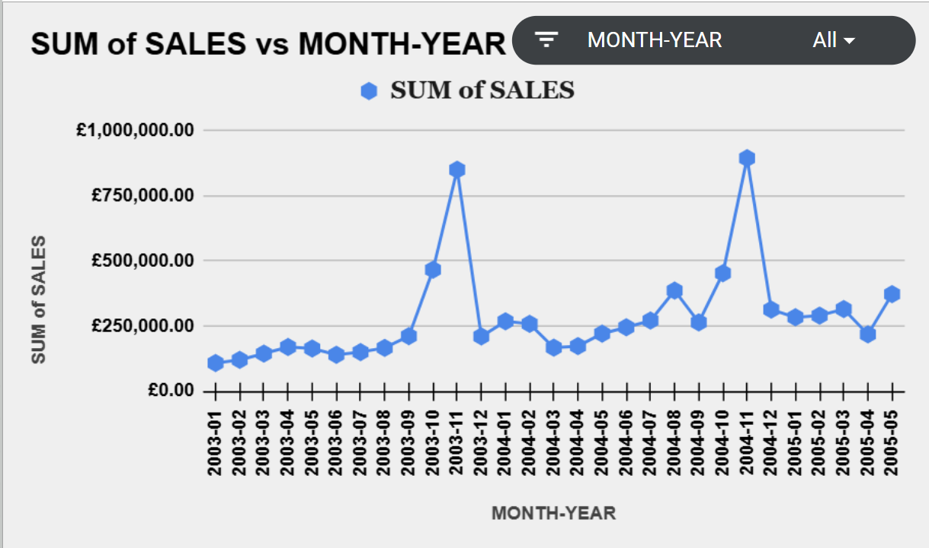
Sales Over Time (Monthly Trend)
Clear November spikes each year indicate strong Q4 demand.
Recommend holiday-season inventory planning and marketing push

Slide 4
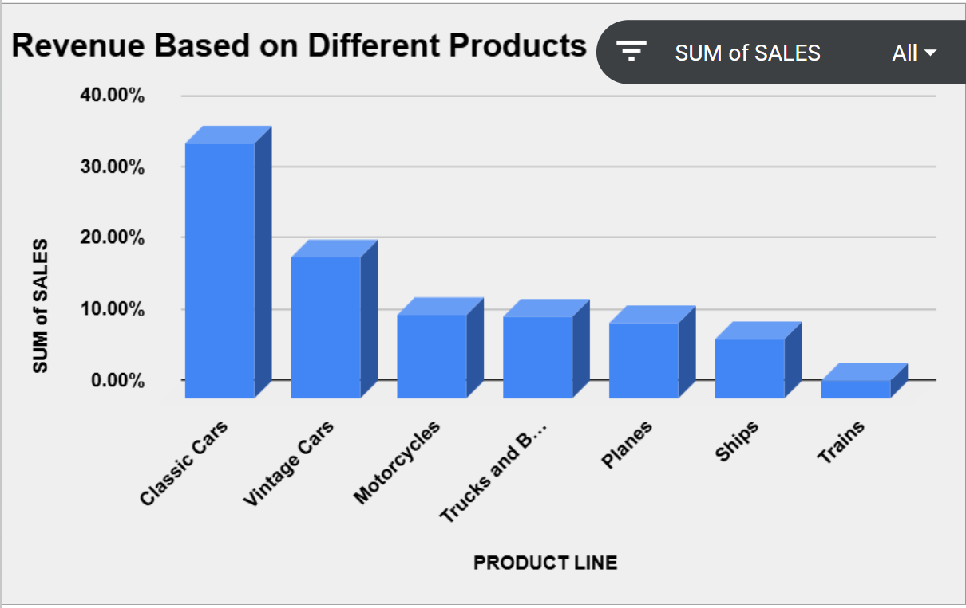
Top Performing Product Lines
Classic Cars ($2.97M) and Vintage Cars ($1.64M) generate over 50% of total revenue.
Prioritize inventory, promotions, and supplier relationships for these categories.

Slide 5
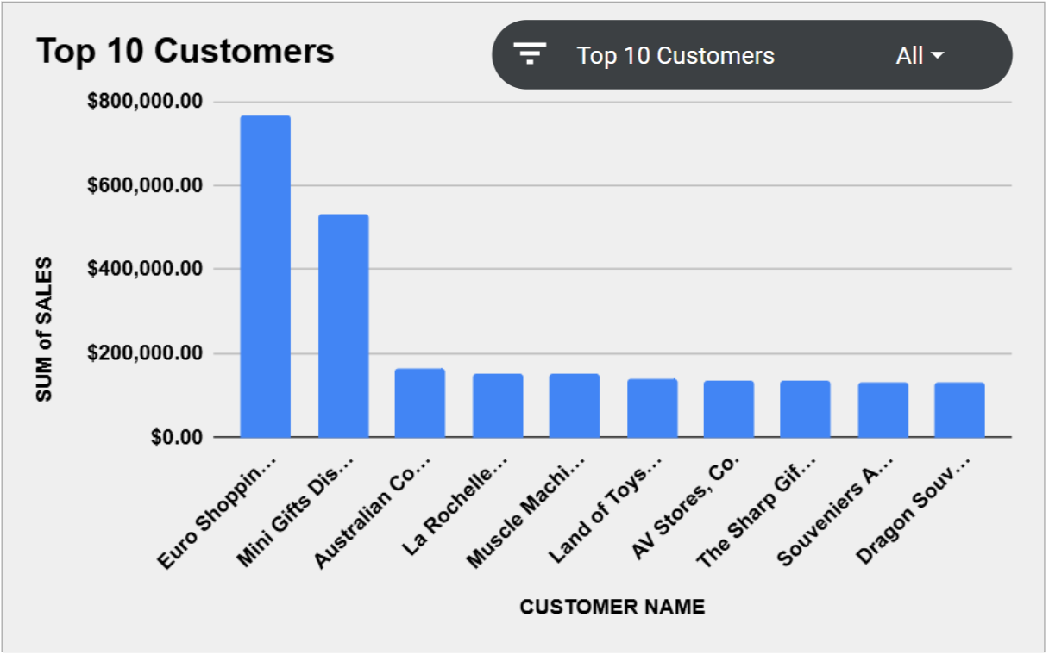
Top 10 Revenue-Contributing Customers
Top 10 customers contribute ~29% of total revenue (~$2.44M).
Launch loyalty or retention programs to strengthen partnerships.

Slide 6
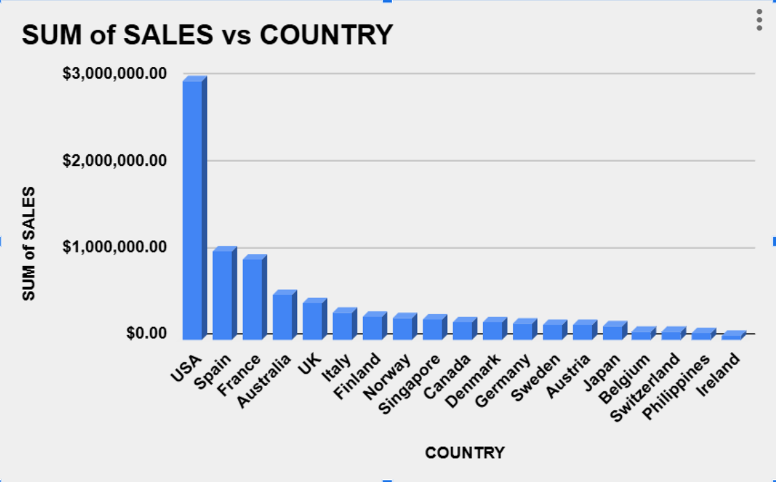
Sales by Country
USA leads with $2.98M (~36% of sales), followed by France and Spain.
Focus marketing and logistics in North America & Western Europe

Slide 7
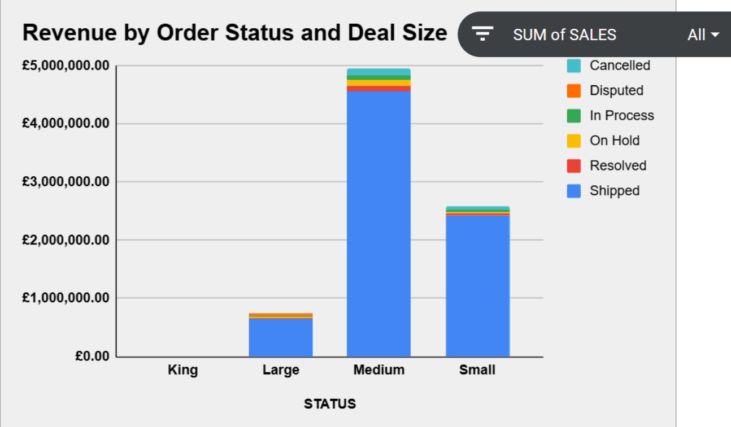
Revenue by Order Status and Deal Size
Shipped orders dominate revenue ($7.65M, ~92%).
Most revenue comes from Medium deal sizes (~$4.96M).
Ensure efficient fulfillment and monitor medium-tier customer satisfaction.

Slide 8
Focus on Classic & Vintage Cars – top revenue drivers.
Plan inventory for Q4 spikes (especially November).
Expand focus in USA, France, and Spain markets.
Build customer retention program for top clients.
Recommendations & Next Steps

Slide 9
Data from 2003–2005 (2,823 orders, $8.29M sales).
Sales = QuantityOrdered × PriceEach.
Cleaned phone and date fields.
Built entirely in Google Sheets (Pivot Tables + Charts).
Appendix &
Data Notes

